Slide 1



Cancer Surveillance: From Data to Public Health Action
Synchronous Session: Concepts, Practice & Application
Rauf Shah, MPH-EPI (Fall 2025)
Course:
PUBLIC HEALTH TEACHING AND TRAINING

Slide 2



Learning Objectives
Define & Compare
Apply Rules
Identify Workflow
Distinguish between passive, active, sentinel, and syndromic surveillance methods.
Utilize ICD-O-3, staging systems, and reportability rules to classify cases accurately.
Map the end-to-end data lifecycle from case finding to quality reporting.

Slide 3
Session Agenda
Introduction & Poll: Assessing our baseline knowledge.
Types & Definitions: The "What" and "How" of surveillance.
Workflow & Reporting: The journey of a data point.
Breakout Session: Applying concepts to a "Rural Spike" mystery.
Practical Applications & Q&A: Wrap-up and next steps.

Slide 4



Live Poll
Check-In Question
How confident are you currently in defining 'Passive' vs 'Active' surveillance?
Instructions: Please select your answer in the Zoom poll window.

Slide 5
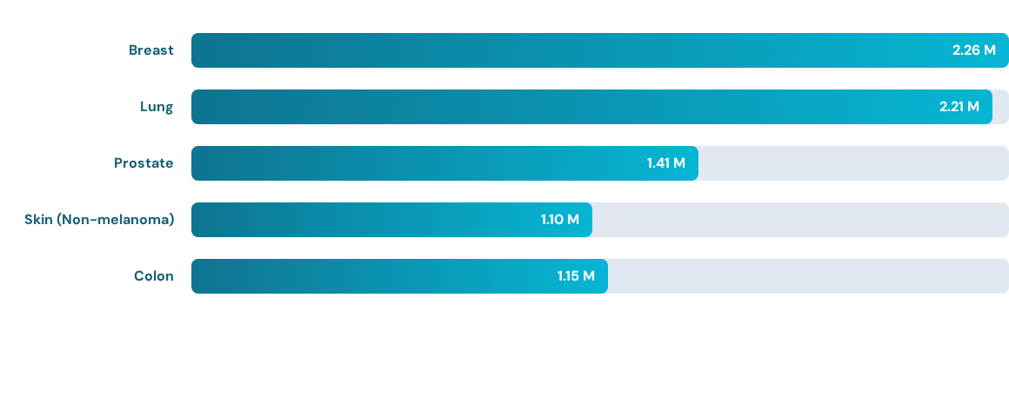
Global Cancer Burden: Incidence (2022)
Breast and Lung cancer account for the highest volume of new cases globally.

Slide 6
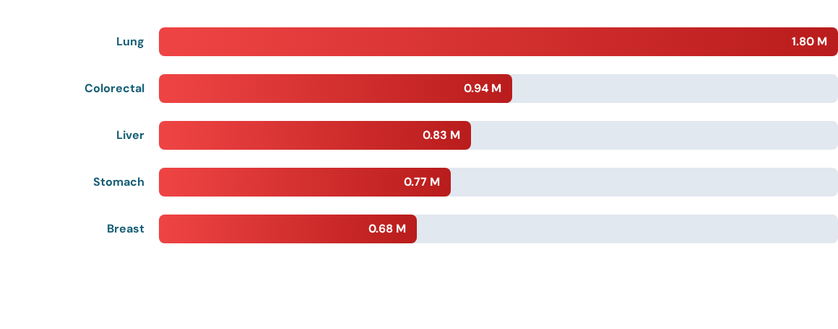
Global Cancer Burden: Mortality (2022)
Lung cancer dominates mortality, highlighting the need for early detection.

Slide 7

The Burden Summary
Incidence Insights
Mortality Insights
~20 million new cases annually.
Breast cancer is the most diagnosed.
High prevalence implies a growing need for survivorship care.
~9.7 million deaths annually.
Lung cancer is the leading cause of death.
Disparities in outcomes persist globally.

Slide 8
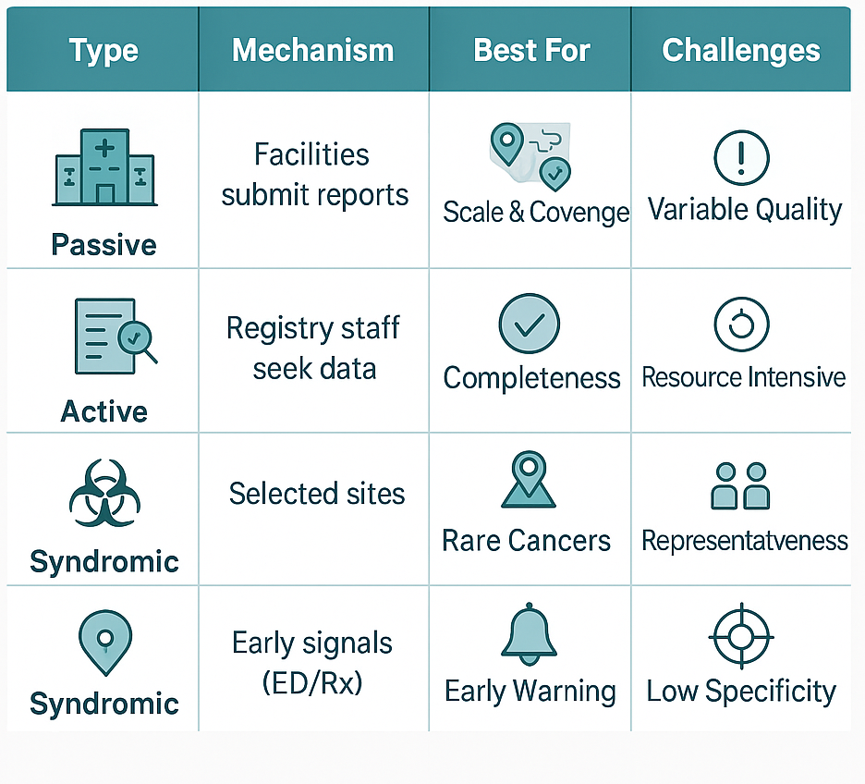
Surveillance Approaches

Slide 9
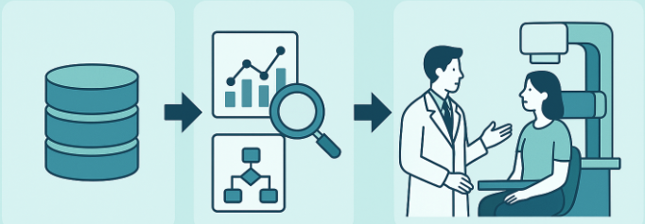
From Data to Screening
Lung: Low-dose CT for high-risk smokers.
Breast: Mammograms for women 40+.
Colorectal: Colonoscopy or Stool tests for 45+.
Prostate: PSA testing for men 45+.
Effective surveillance identifies at-risk populations to target these interventions.

Slide 10
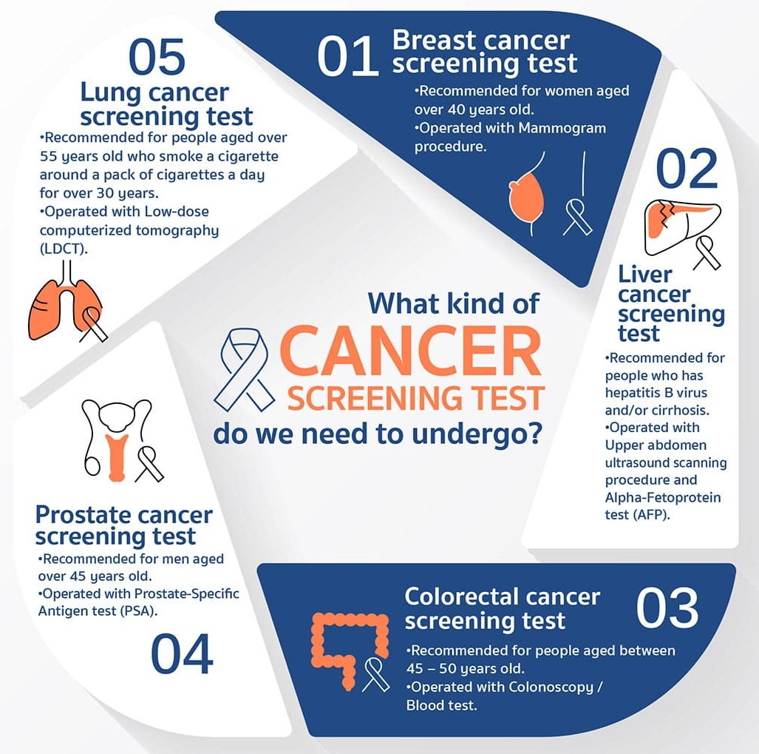
Right Data → Right Test → Right Time
Surveillance turns signals into saved lives.

Slide 11


Defining the Case
ICD-O-3 Standards
Reportability Rules
The global standard for coding cancer cases.
Determines which cases must be included in the registry.
Topography: Site of origin (e.g., C50.9 Breast)
Morphology: Cell type (e.g., 8500/3 Infiltrating Duct)
Malignant (/3): Always reportable.
In Situ (/2): Most are reportable
Benign (/0): Generally not, except CNS.

Slide 12



Staging & Rules
TNM Staging
SEER Summary
Date Rules
Tumor size
Nodes involved
Metastasis.
Localized
Regional
Distant.
Anchor to the first definitive diagnosis (usually the pathology report date).
Used for clinical treatment planning
Used for population-level comparison and Epidemiology

Slide 13
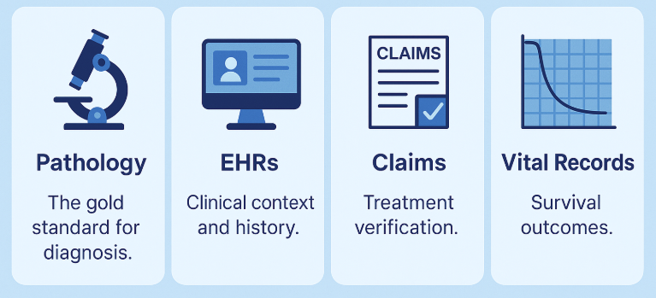
The Data Ecosystem
Cancer data is an aggregation of multiple streams:

Slide 14





5 Dimensions of Data Quality
Are we capturing all eligible cases?
Is data available rapidly enough for action?
Is the data correct and valid?
Are standards applied uniformly over time?
Are there duplicates in the System?

Slide 15
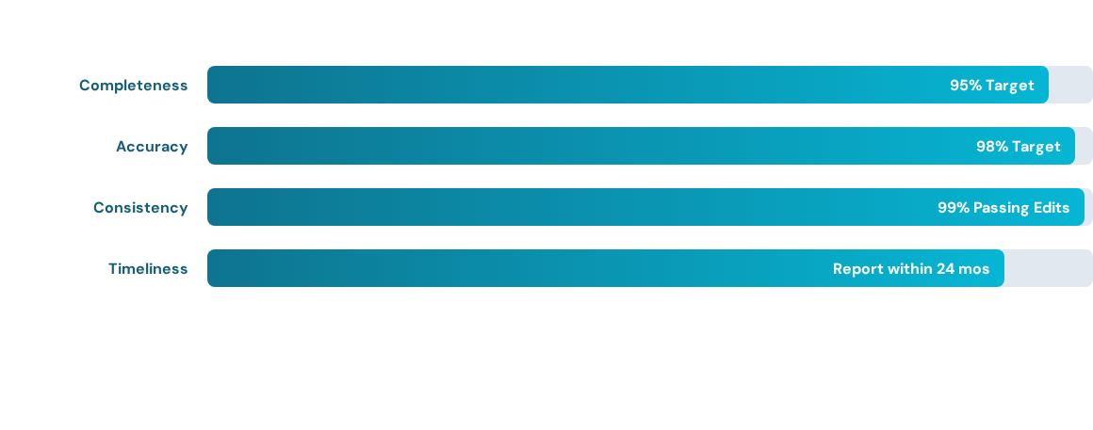
NPCR Data Quality Targets
Meeting these standards ensures data is “Fit for Use”

Slide 16



Breakout Session: The “Rural Spike”
Group Activity
Task Overview (10 Mins)
Scenario: A 20% spike in late-stage lung cancer in a rural county after a new EHR rollout.
Your Mission:
Is this a real cluster or a data artifact?
Which Quality Dimension is at risk?
Propose one check to verify.

Slide 17
Privacy & Security Cycle
Protecting Patient Trust
RBAC: Role-Based Access Control ensures only authorized staff see data
Encryption: Data is encrypted in transit (VPN) and at rest.
Audit Logs: Every access is tracked and monitored.

Slide 18




Reporting Safely
Balancing usefulness and privacy in Cancer data
Small-Cell Suppression
Aggregation
Never publish counts fewer than <5-10 cases (follow state laws and policy).
Combine or suppress cells to prevent re-identification in small populations
Report data by larger geographic areas (e.g., region vs. zip code)
Use multi-year aggregates (e.g., 3-5-years) to ensure statistical stability and privacy.
Goal: useful data, low disclosure risk

Slide 19



Session Resources
Skeleton Notes
Case Study Guide
A fillable handout to help you follow along and capture key metrics during the session.
Check the chat for the download link.
A reference sheet for the "Rural Spike" breakout activity, including the rubric for your group's diagnosis.

Slide 20
Questions?
Thank you for your active participation.
Next Steps: Complete the post-session assessment.
Contact:
abrshah@unmc.edu

